Slide 1

Notes:
Video URL: https://player.vimeo.com/external/413009275.hd.mp4?s=76f945215fa44cd3bec8a1097d1c1f4f9c487197&oauth2_token_id=57447761

Slide 2
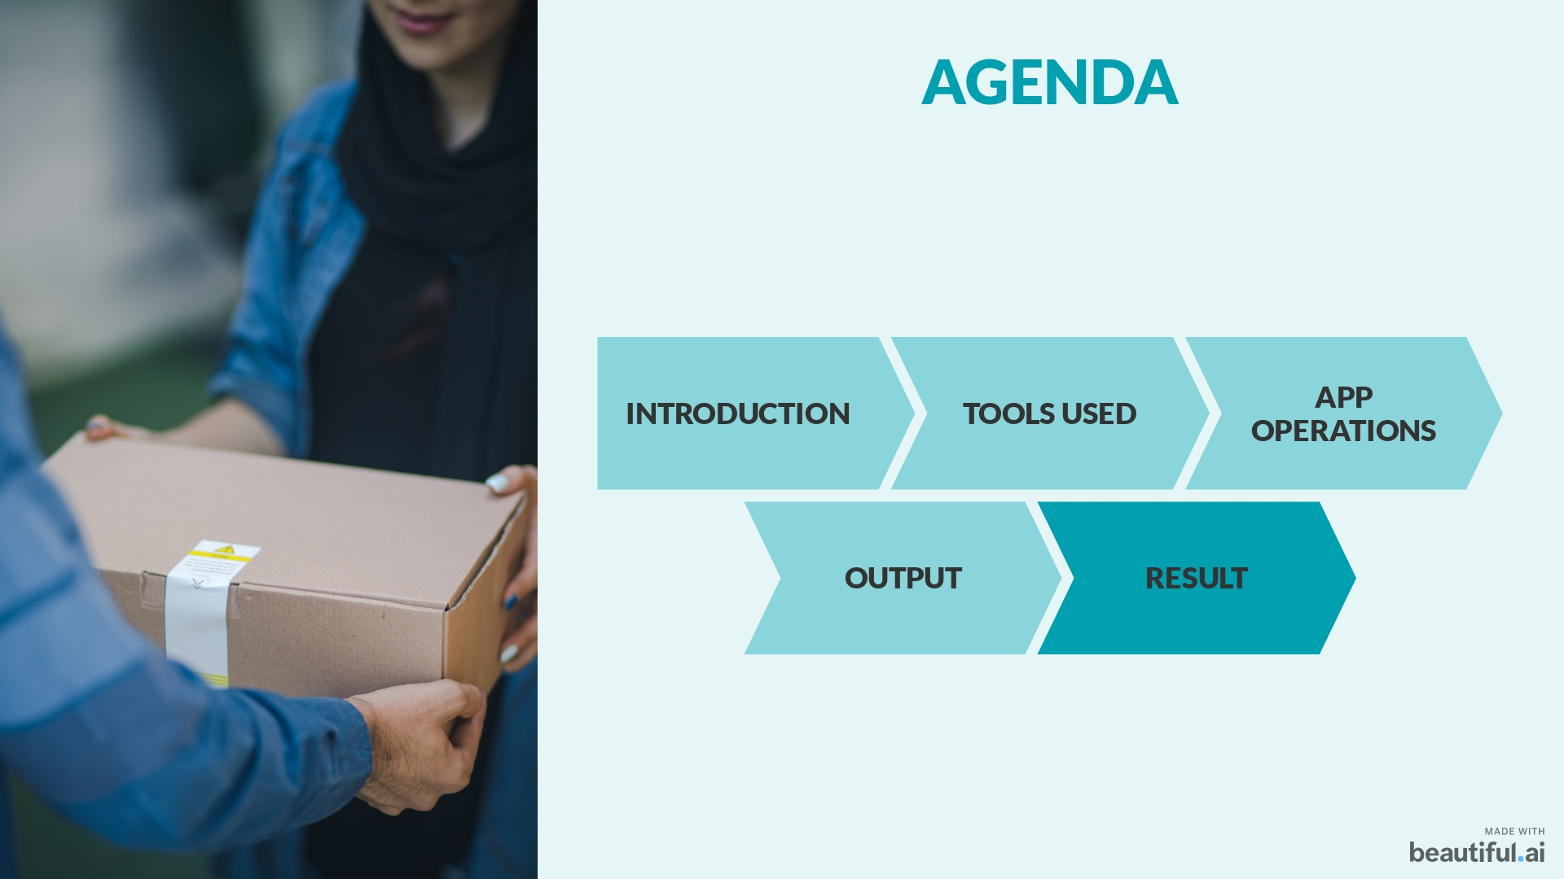

Slide 3
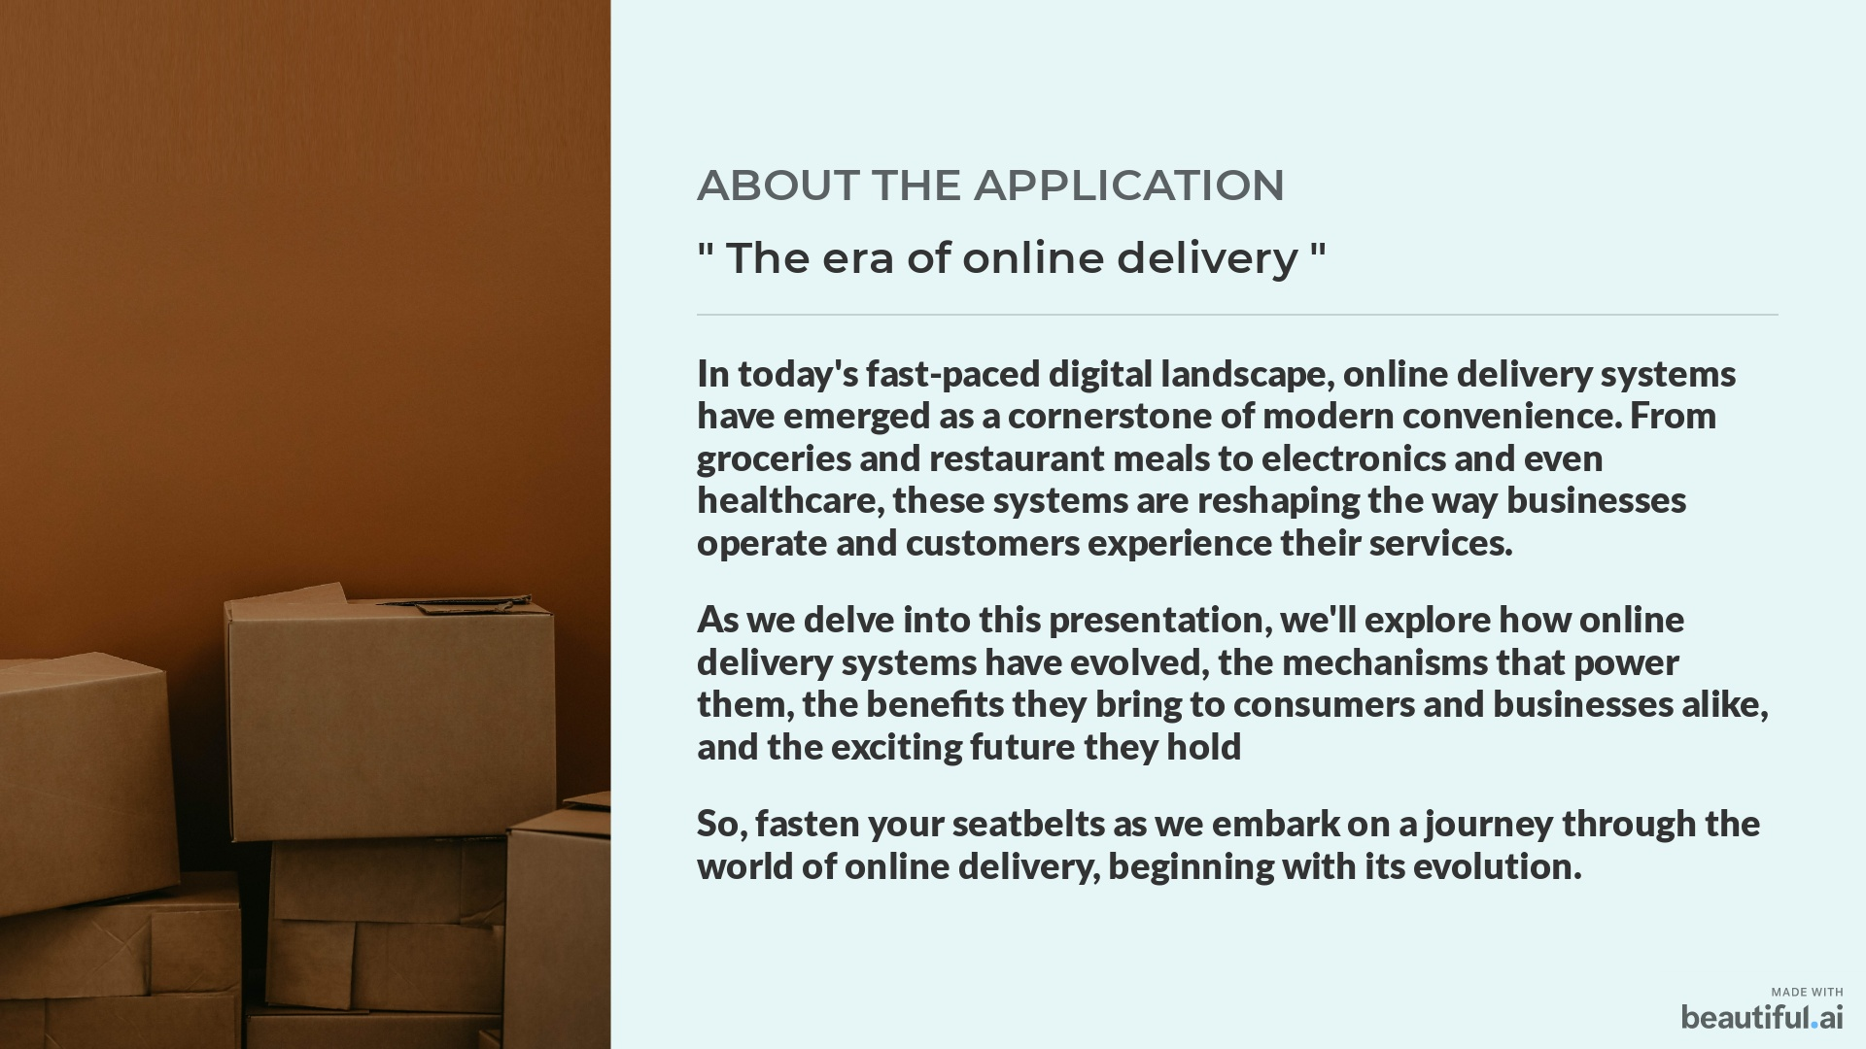

Slide 4
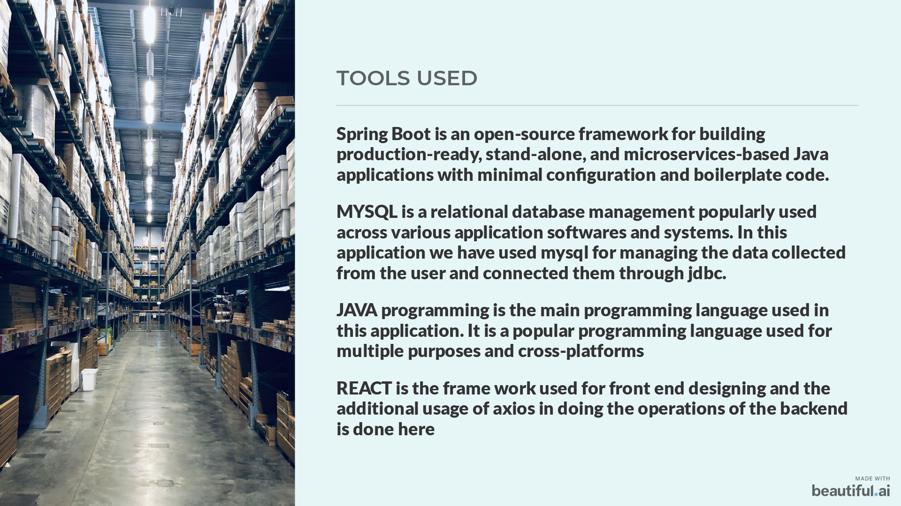

Slide 5
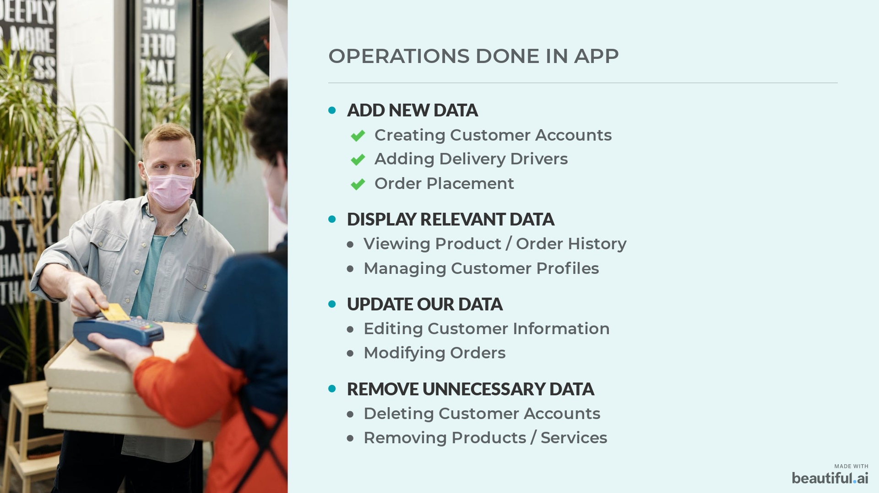

Slide 6
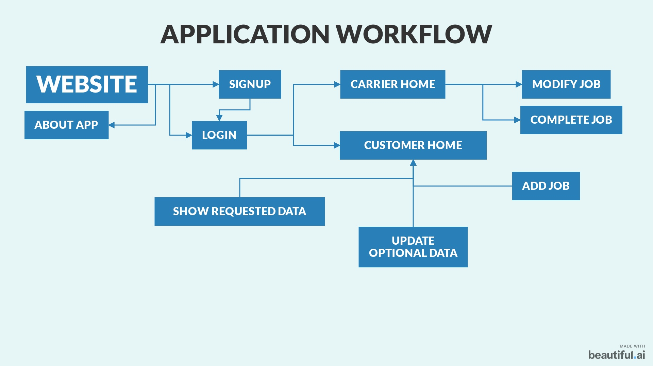

Slide 7

